Slide 1

UPI Fraud Risk Scoring and Anomaly Detection
DATA SCIENCE (24AD3107) Project Review-1
 | Under the Guidance of Ms. Prathusha Assistance Professor, Department of Computer Science and Engineering, KLH CSE Bowrampet Campus
Team Members 2420030547 – Monika Sri 2420030308 – Snigdha 2420040041 - Mihika

Slide 2

Outline of Project Work
Focus
Introduction
Literature Survey
Challenges
Research Objectives
Conclusion & Future Work
References
Publications Details

Slide 3
Problem Statement
UPI fraud is increasing with the growth of digital payments.
Traditional methods may miss new or unusual fraud patterns.
Analyzing large numbers of transactions manually is difficult.
The project aims to detect suspicious transactions using anomaly detection.
Each transaction will receive a fraud risk score. The goal is to identify fraud early and improve UPI transaction security.

Slide 4
Objectives
Detect fraudulent UPI transactions by analyzing transaction data and identifying suspicious activities.
Identify unusual patterns using anomaly detection and machine learning techniques.
Assign a fraud risk score to each transaction based on factors like amount, time, frequency, and location.
Improve UPI security by enabling early detection of potentially fraudulent transactions and reducing false alerts.

Slide 5
Literature Survey
Authors | Title of the Paper | Methodology | Inferences | Limitation / Future Work
M. Nazmoddin et al. | UPI Fraud Detection Using Machine Learning | • Machine Learning • Transaction data analysis | • Detects suspicious UPI transactions • Helps identify fraud | • New types of fraud may not be detected • Needs better real-time detection
Secure UPI | Machine Learning-Based Fraud Detection for UPI | • Machine Learning • Transaction features like amount, time and location | • Helps classify transactions as genuine or fraudulent | • Needs large and accurate data • Fraud patterns keep changing
Tholapi Sri Kartik et al. | Adaptive UPI Fraud Detection | • Machine Learning • Anomaly detection | • Detects unusual transaction behavior • Helps identify complex fraud | • Data imbalance can affect results • Needs testing with more real-world data

Slide 6
Problem Gap Identification
Traditional methods are limited –
Rule-based systems may fail to detect new and complex fraud patterns.
False alerts – Genuine transactions may sometimes be incorrectly marked as fraudulent.
Large transaction volume – Millions of UPI transactions make manual fraud detection difficult.
Need for real-time detection – There is a need for data-driven systems that can quickly identify unusual transactions and assign a risk score.10:26 AM

Slide 7
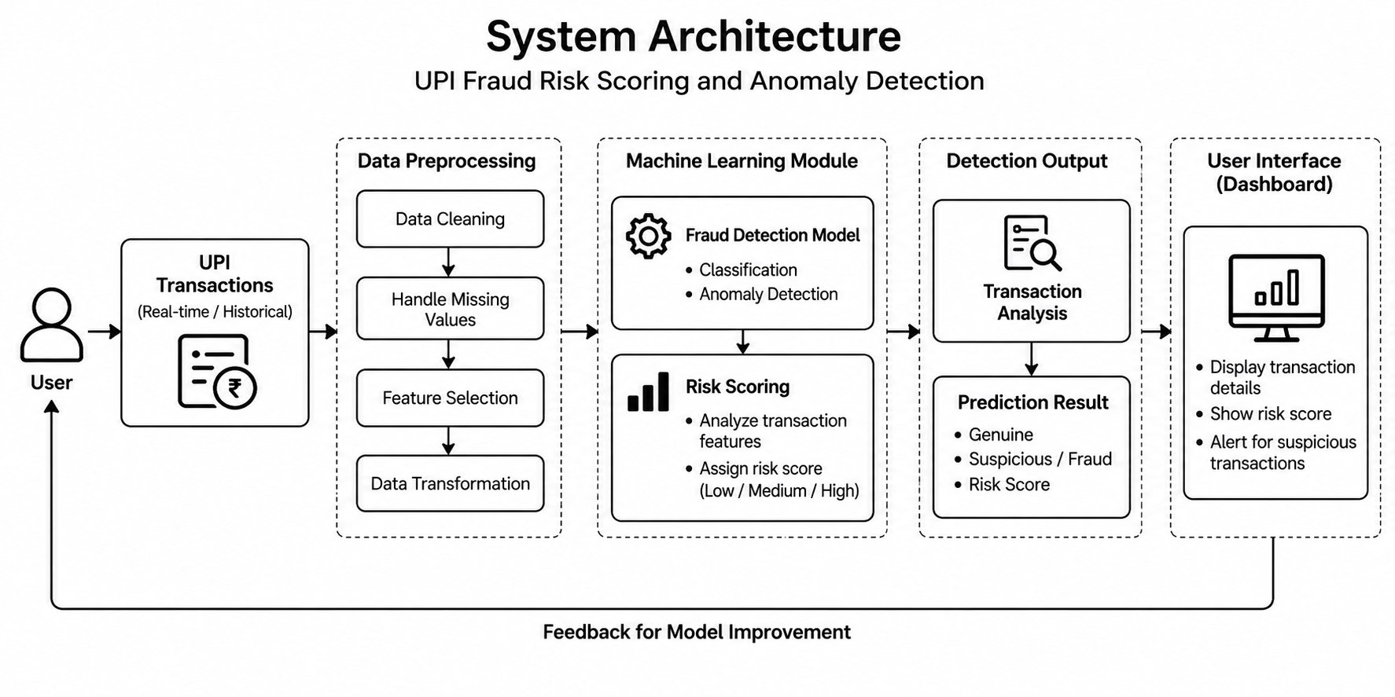

Slide 8
Innovation, Creativity, and Novelty
Fraud Risk Score: Gives each UPI transaction a risk score based on how suspicious it is.
Anomaly Detection: Identifies unusual transaction patterns that may indicate new types of fraud.
Multiple Factors: Analyzes amount, time, frequency, location, and transaction behavior together.
Early Detection: Helps identify suspicious transactions quickly before major loss occurs.

Slide 9
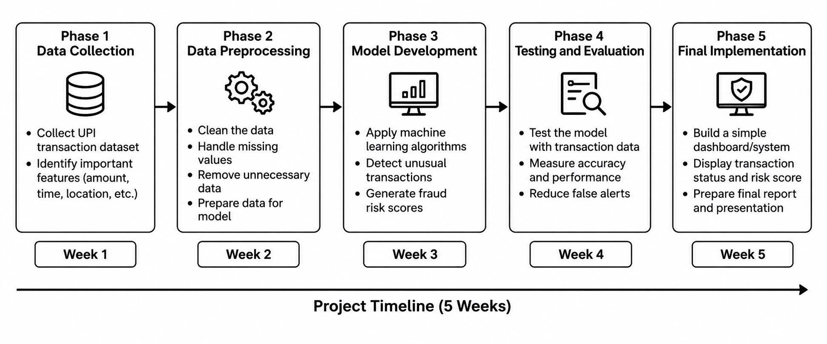
Feasibility and Project Plan
TIMELINE CHART FOR EACH PHASE OF YOUR PROJECT SHOULD BE THERE AFTER EXPLANATION

